Slide 1
Hierarchical Clustering in Machine Learning

Slide 2
Hierarchical clustering is another unsupervised machine learning algorithm, which is used to group the unlabeled datasets into a cluster and also known as hierarchical cluster analysis or HCA.
In this algorithm, we develop the hierarchy of clusters in the form of a tree, and this tree-shaped structure is known as the dendrogram.

Slide 3
The hierarchical clustering technique has two approaches:
Agglomerative: Agglomerative is a bottom-up approach, in which the algorithm starts with taking all data points as single clusters and merging them until one cluster is left.
Divisive: Divisive algorithm is the reverse of the agglomerative algorithm as it is a top-down approach.

Slide 4
Why hierarchical clustering?
a predetermined number of clusters.
it always tries to create the clusters of the same size.

Slide 5
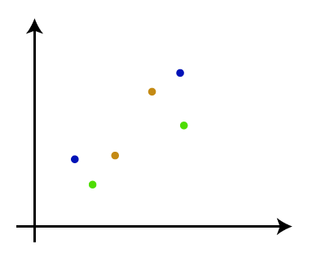
Agglomerative Hierarchical clustering
Step-1: Create each data point as a single cluster. Let's say there are N data points, so the number of clusters will also be N.

Slide 6
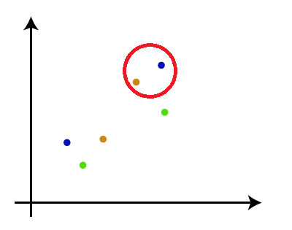
Step-2: Take two closest data points or clusters and merge them to form one cluster. So, there will now be N-1 clusters.

Slide 7
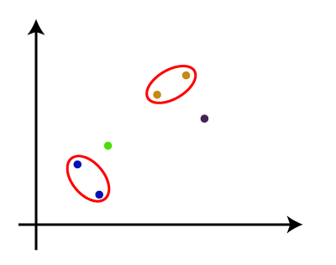
Step-3: Again, take the two closest clusters and merge them together to form one cluster. There will be N-2 clusters.

Slide 8
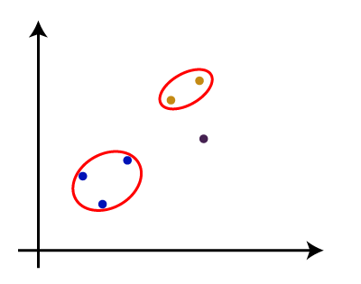
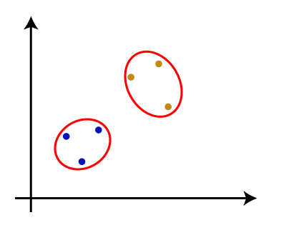
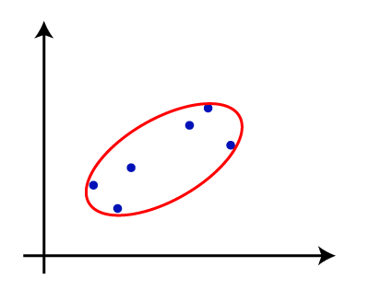
Step-4: Repeat Step 3 until only one cluster left. So, we will get the following clusters. Consider the below images:

Slide 9
Step-5: Once all the clusters are combined into one big cluster, develop the dendrogram to divide the clusters as per the problem.

Slide 10
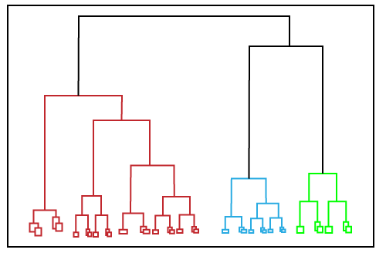
Dendrogram

